Slide 1
Al-Farabi Kazakh National University
Higher School of Medicine
ACID–BASE BALANCE

Slide 2
LEARNING OUTCOMES
As a result of the lesson you will be able to:
Define buffer and write chemical equations for the bicarbonate, phosphate, and protein buffer systems;
Discuss the relationship between pulmonary ventilation, pH of the extracellular fluids, and the bicarbonate buffer system;
Explain how the kidneys secrete hydrogen ions and how these ions are buffered in the tubular fluid;
Identify some types and causes of acidosis and alkalosis, and describe the effects of these pH imbalances;
explain how the respiratory and urinary systems correct acidosis and alkalosis, and compare their effectiveness and limitations.
Al-Farabi Kazakh National University
Higher School of Medicine

Slide 3
Acid-Base Balance
one of the most important aspects of homeostasis
metabolism depends on enzymes, and enzymes are sensitive to pH
slight deviation from the normal pH can shut down entire metabolic pathways
slight deviation from normal pH can alter the structure and function of macromolecules
7.35 to 7.45 is the normal pH range of blood and tissue fluid
challenges to acid-base balance:
metabolism constantly produces acid
lactic acids from anaerobic fermentation
phosphoric acid from nucleic acid catabolism
fatty acids and ketones from fat catabolism
carbonic acid from carbon dioxide

Slide 4
Acids and Bases
pH of a solution is determined solely by its hydrogen ions (H⁺)
acids – any chemical that releases H⁺ in solution
strong acids like hydrochloric acid (HCl) ionize freely
gives up most of its H⁺
markedly lower pH of a solution
weak acids like carbonic acid (H₂CO₃) ionize only slightly
keeps most H⁺ chemically bound
does not affect pH
bases – any chemical that accepts H⁺
strong bases, like the hydroxide ion (OH⁻), has a strong tendency to bind H⁺, markedly raising pH
weak bases, such as the bicarbonate ion (HCO³⁻) bind less available H⁺ and has less effect on pH

Slide 5
Buffers
buffer – any mechanism that resists changes in pH
convert strong acids or bases to weak ones
physiological buffer - system that controls output of acids, bases or CO₂
urinary system buffers greatest quantity of acid or base
takes several hours to days to exert its effect
respiratory system buffers within minutes
cannot alter pH as much as the urinary system
chemical buffer – a substance that binds H⁺ and removes it from solution as its concentration begins to rise, or releases H⁺ into solution as its concentration falls
restore normal pH in fractions of a second
function as mixtures called buffer systems composed of weak acids and weak bases
three major chemical buffers : bicarbonate, phosphate, and protein systems
amount of acid or base neutralized depends on the concentration of the buffers and the pH of the working environment

Slide 6
Bicarbonate Buffer System
bicarbonate buffer system – a solution of carbonic acid and bicarbonate ions.
carbonic acid and bicarbonate ions
CO₂ + H₂O ↔ H₂CO₃ ↔ HCO₃⁻ + H⁺
reversible reaction important in ECF
CO₂ + H₂O → H₂CO₃ → HCO₃⁻ + H⁺
lowers pH by releasing H⁺
CO₂ + H₂O ← H₂CO₃ ← HCO₃⁻ + H⁺
raises pH by binding H⁺
functions best in the lungs and kidneys to constantly remove CO₂
to lower pH, kidneys excrete HCO₃⁻
to raise pH, kidneys excrete H⁺ and lungs excrete CO₂

Slide 7
Phosphate Buffer System
phosphate buffer system - a solution of HPO₄²⁻ and H₂PO₄⁻
H₂PO₄⁻ ↔ HPO₄²⁻ + H⁺
as in the bicarbonate system, reactions that proceed to the right liberating H⁺ and decreasing pH, and those to the left increase pH
more important buffering the ICF and renal tubules
where phosphates are more concentrated and function closer to their optimum pH of 6.8
constant production of metabolic acids creates pH values from 4.5 to 7.4 in the ICF, avg. 7.0

Slide 8
Protein Buffer System
proteins are more concentrated than bicarbonate or phosphate systems, especially in the ICF
protein buffer system accounts for about three-quarters of all chemical buffering in the body fluids
protein buffering ability is due to certain side groups of their amino acid residues
carboxyl (-COOH) side groups which releases H⁺ when pH begins to rise
others have amino (-NH₂) side groups that bind H⁺ when pH gets too low

Slide 9
Respiratory Control of pH
basis for the strong buffering capacity of the respiratory system
the addition of CO₂ to the body fluids raises the H⁺ concentration and lowers pH
the removal of CO₂ has the opposite effects
neutralizes 2 to 3 times as much acid as chemical buffers
CO₂ is constantly produced by aerobic metabolism
normally eliminated by the lungs at an equivalent rate
CO₂ + H₂O → H₂CO₃ → HCO₃⁻ + H⁺
lowers pH by releasing H⁺
CO₂ (expired) + H₂O ← H₂CO₃ ← HCO₃⁻ + H⁺
raises pH by binding H⁺
increased CO₂ and decreased pH stimulate pulmonary ventilation, while an increased pH inhibits pulmonary ventilation

Slide 10
Renal Control of pH
the kidneys can neutralize more acid or base than either the respiratory system or chemical buffers
renal tubules secrete H⁺ into the tubular fluid
most binds to bicarbonate, ammonia, and phosphate buffers
bound and free H⁺ are excreted in the urine actually expelling H⁺ from the body
other buffer systems only reduce its concentration by binding it to other chemicals

Slide 11
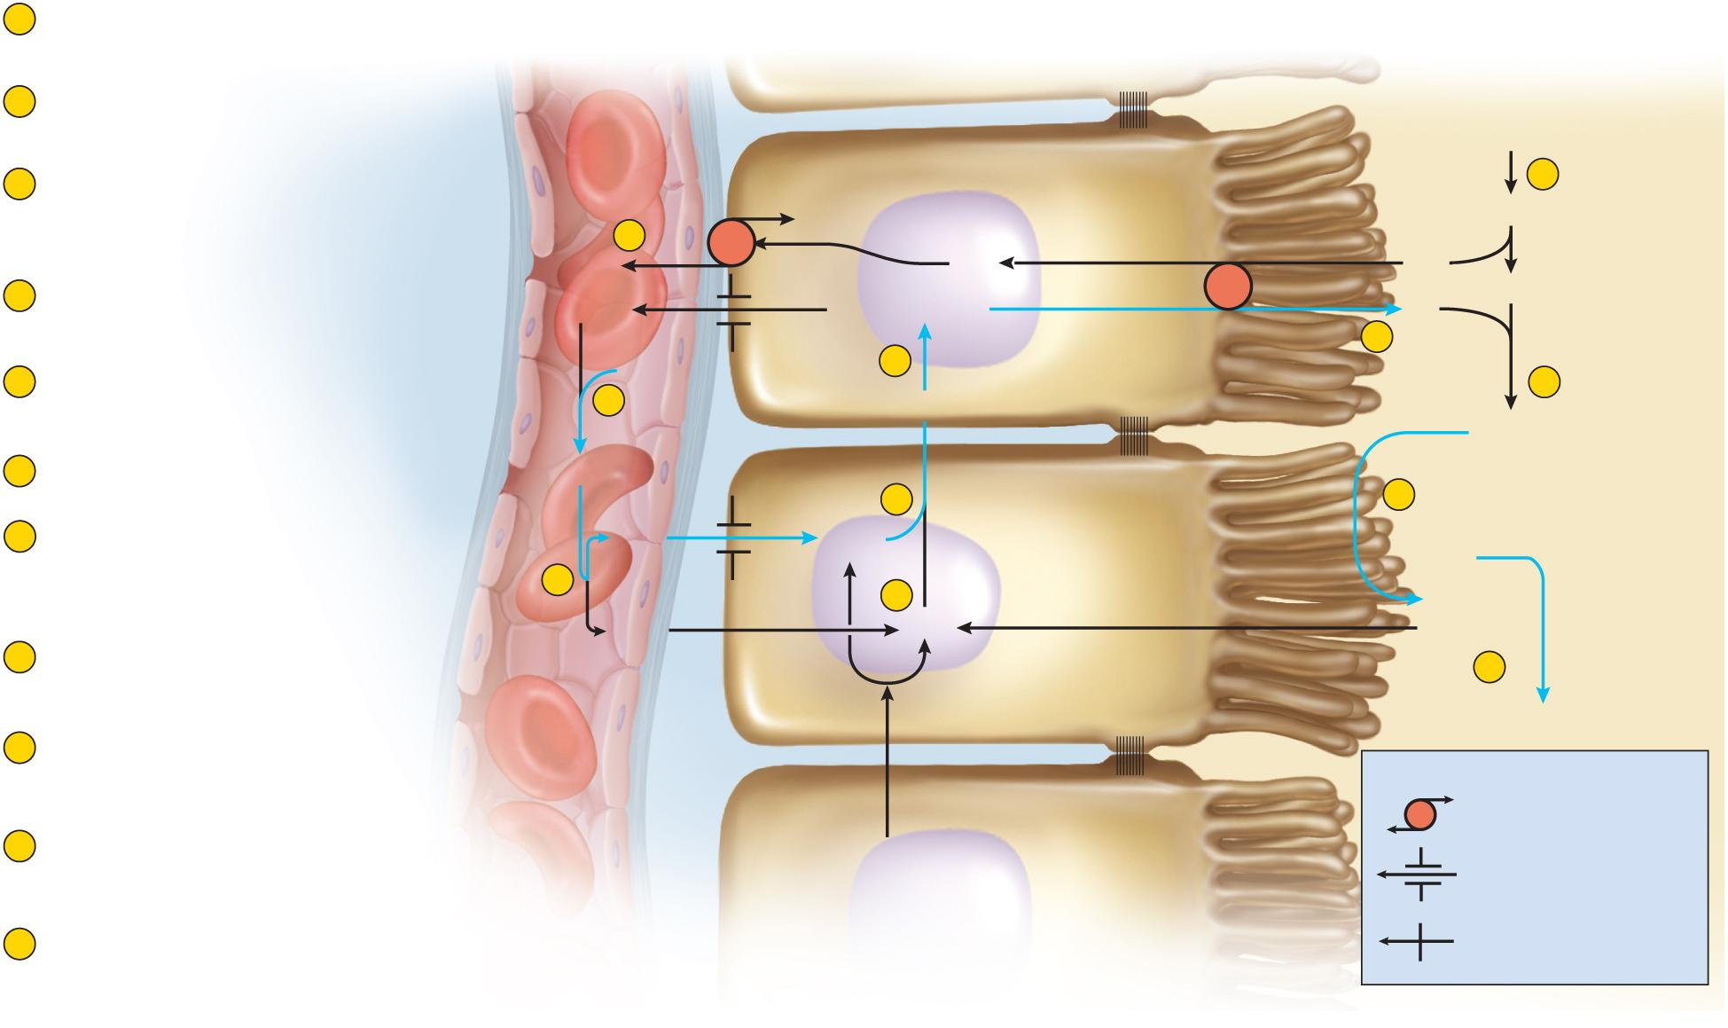
H⁺ Secretion and Excretion in Kidney
Copyright © The McGraw-Hill Companies, Inc. Permission required for reproduction or display.
1
H⁺ in blood reacts with HCO₃– to
form H₂CO₃.
Blood of
peritubular capillary
Renal tubule cells
(proximal convoluted tubule)
Tubular fluid
2
H₂CO₃ decomposes into H₂O and
CO₂, which enter the tubule cell.
Glomerular
filtrate
3
Tubule cells acquire CO₂ from
blood, tubular fluid, and their own
aerobic respiration.
7
8
K⁺
NaHCO₃
Na⁺
Na⁺
Na⁺
–
4
Carbonic anhydrase (CAH) combines
H₂O and CO₂ to re-form H₂CO₃.
HCO₃
–
HCO₃
–
+
H⁺
H⁺
HCO₃
5
6
5
H₂CO₃ ionizes to form HCO₃– (which
returns to the blood) and H⁺.
H⁺
9
1
H₂CO₃
6
Na⁺–H⁺ antiport exchanges H⁺ for Na⁺.
H₂CO₃
4
CAH
10
CAH
7
NaHCO₃ from glomerular filtrate
decomposes into Na⁺ and HCO₃–.
Na⁺ is pumped into tubule cell.
H₂O
H₂O
H₂O
2
3
+
CO₂
CO₂
CO₂
8
Na⁺ is removed by Na⁺–K⁺
pump at the base of the cell.
11
Urine
9
HCO₃– reacts with H⁺ from tubule
cell to form H₂CO₃.
Key
Antiport
10
CAH on brush border decomposes
H₂CO₃ to H₂O and CO₂ again.
Aerobic respiration
Diffusion through a
membrane channel
11
CO₂ enters the tubular cell and H₂O passes in the
urine (carrying the H⁺ that was originally in the blood).
Diffusion through the
membrane lipid
Figure 24.10

Slide 12
Limiting pH
tubular secretion of H⁺ (step 6)
continues only with a steep concentration gradient of H⁺ between tubule cells and tubular fluid
if H⁺ concentration increased in tubular fluid, lowering pH to 4.5, secretion of H⁺ stops – limiting pH
this is prevented by buffers in tubular fluid
bicarbonate system – all bicarbonate ions in tubular fluid are consumed neutralizing H⁺
so there is no HCO³⁻ in the urine
the more acid the kidneys secrete, less sodium is in the urine
phosphate system - dibasic sodium phosphate is contained in glomerular filtrate
reacts with some of the H⁺ replacing a Na⁺ in the buffer which passes into the urine
Na₂HPO₄ + H⁺ → NaH₂PO₄ + Na⁺
ammonia (NH₃) - from amino acid catabolism acts as a base to neutralize acid
NH₃ + H⁺ and Cl⁻ → NH₄Cl (ammonium chloride – a weak acid)

Slide 13
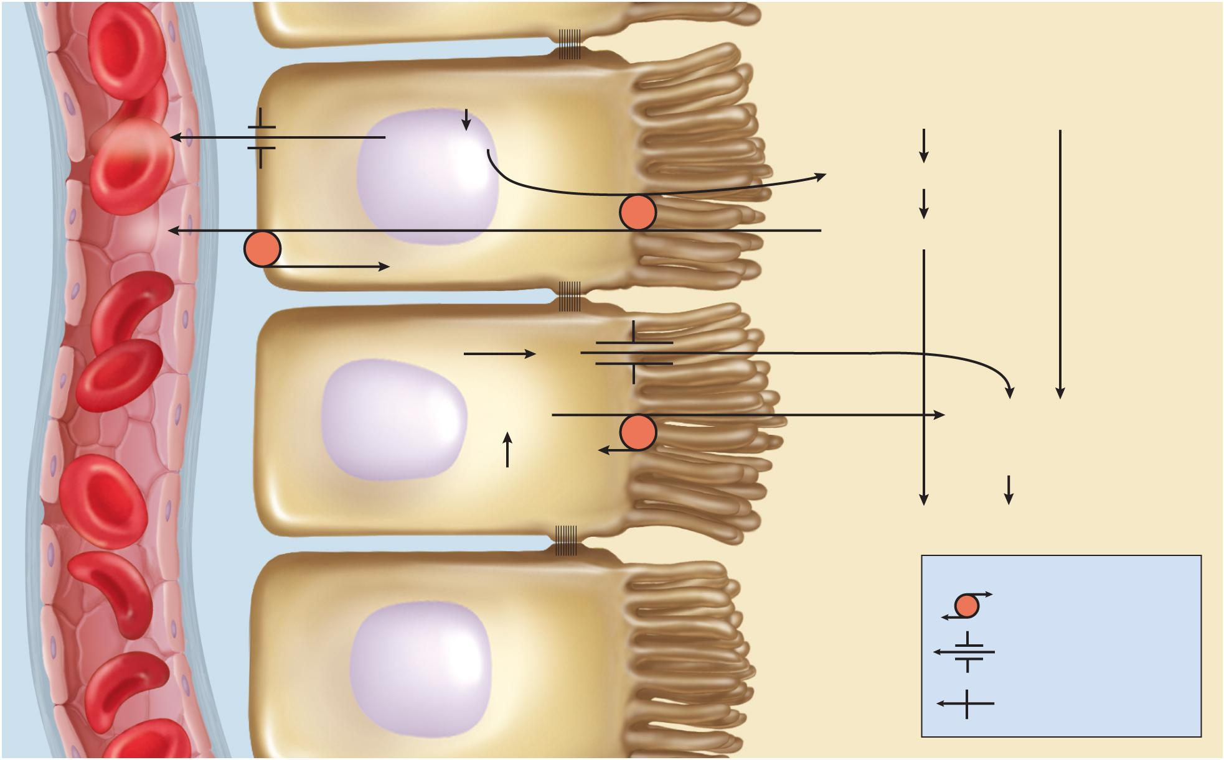
Buffering Mechanisms in Urine
Blood of
peritubular
capillary
Copyright © The McGraw-Hill Companies, Inc. Permission required for reproduction or display.
Renal tubule cells
(proximal convoluted tubule)
Tubular fluid
H₂CO₃
Glomerular filtrate
HCO₃
–
HCO₃
–
+
H⁺
H⁺ + Na₂HPO₄
Na⁺
Na⁺ +NaH₂PO₄
K⁺
Amino acid
catabolism
NH₃
HCO₃
–
+
H⁺
H⁺ + NH₃ +Cl–
Na⁺
NH₄Cl
H₂CO₃
Urine
Key
Antiport
Diffusion through a
membrane channel
Diffusion through the
membrane lipid
Figure 24.11

Slide 14
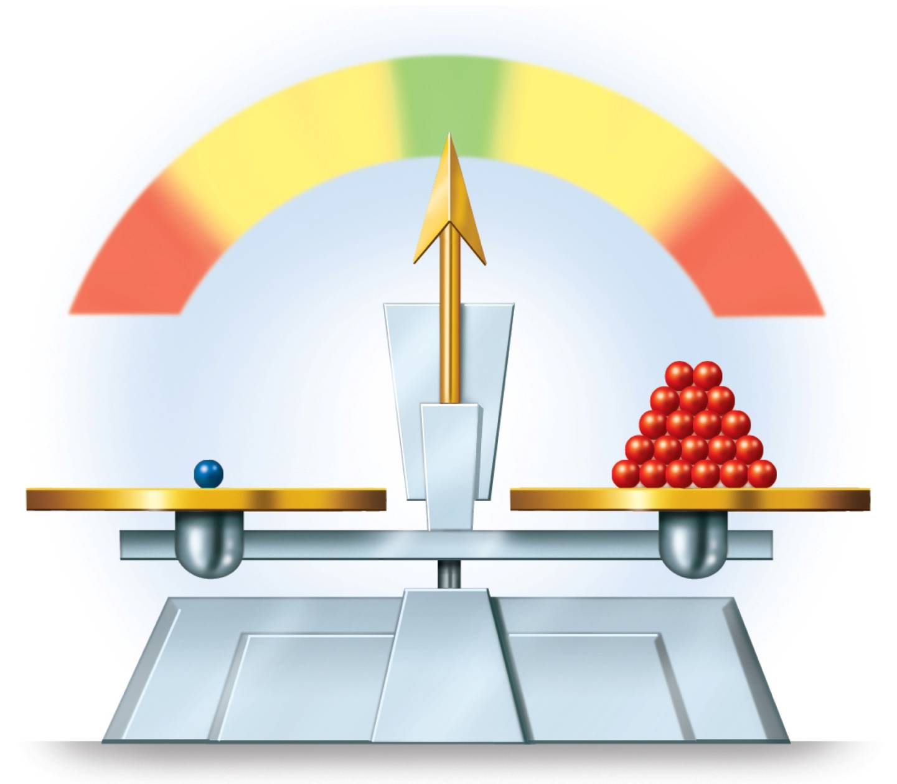
Acid-Base Balance
Copyright © The McGraw-Hill Companies, Inc. Permission required for reproduction or display.
Figure 24.12
pH
Normal
Acidosis
7.35
7.45
Alkalosis
6.8
8.0
Death
Death
H₂CO₃
HCO₃–

Slide 15
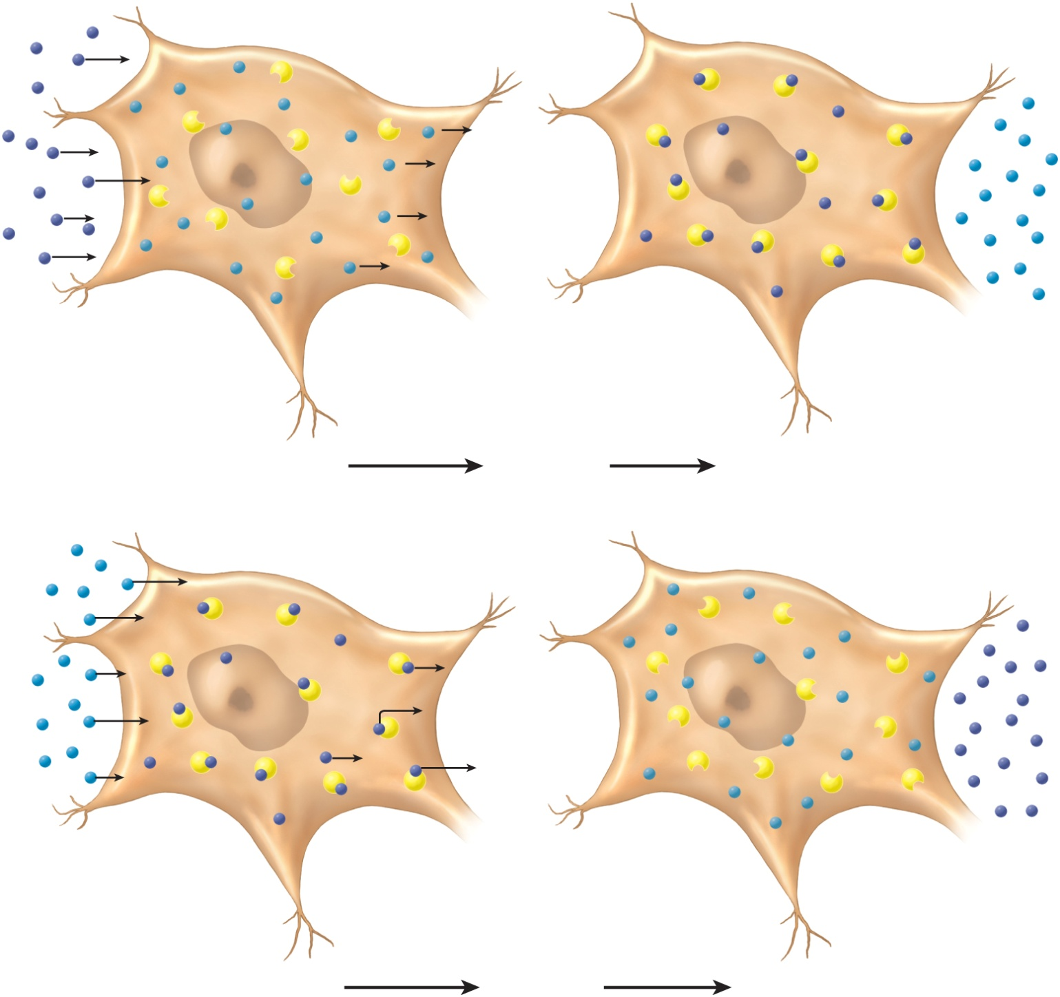
Disorders of Acid-Base Balance
acid – base balance – depends on bicarbonate buffer system
acidosis – pH below 7.35
H⁺ diffuses into cells and drives out K⁺, elevating K⁺ concentration in ECF
H⁺ buffered by protein in ICF, causes membrane hyperpolarization, nerve and muscle cells are hard to stimulate; CNS depression may lead to confusion, disorientation, coma, and possibly death
Copyright © The McGraw-Hill Companies, Inc. Permission required for reproduction or display.
H⁺
K⁺
Protein
(a) Acidosis
leading to
Hyperkalemia
K⁺
H⁺
Protein
Figure 24.13
(b) Alkalosis
leading to
Hypokalemia

Slide 16
Disorders of Acid-Base Balance
alkalosis – pH above 7.45
H⁺ diffuses out of cells and K⁺ diffuses in, membranes depolarized, nerves overstimulated, muscles causing spasms, tetany, convulsions, respiratory paralysis
a person cannot live for more than a few hours if the blood pH is below 7.0 or above 7.7
Copyright © The McGraw-Hill Companies, Inc. Permission required for reproduction or display.
H⁺
K⁺
Protein
(a) Acidosis
leading to
Hyperkalemia
K⁺
H⁺
Protein
Figure 24.13
(b) Alkalosis
leading to
Hypokalemia

Slide 17
Disorders of Acid-Base Balances
acid-base imbalances fall into two categories:
respiratory and metabolic
respiratory acidosis
occurs when rate of alveolar ventilation fails to keep pace with the body’s rate of CO₂ production
carbon dioxide accumulates in the ECF and lowers its pH
occurs in emphysema where there is a severe reduction of functional alveoli
respiratory alkalosis
results from hyperventilation
CO₂ eliminated faster than it is produced

Slide 18
Disorders of Acid-Base Balances
metabolic acidosis
increased production of organic acids such as lactic acid in anaerobic fermentation, and ketone bodies seen in alcoholism, and diabetes mellitus
ingestion of acidic drugs (aspirin)
loss of base due to chronic diarrhea, laxative overuse
metabolic alkalosis
rare, but can result from:
overuse of bicarbonates (antacids and IV bicarbonate solutions)
loss of stomach acid (chronic vomiting)

Slide 19
Compensation for Acid-Base Imbalances
compensated acidosis or alkalosis
either the kidneys compensate for pH imbalances of respiratory origin, or
the respiratory system compensates for pH imbalances of metabolic origin
uncompensated acidosis or alkalosis
a pH imbalance that the body cannot correct without clinical intervention

Slide 20
Compensation for Acid-Base Imbalances
respiratory compensation – changes in pulmonary ventilation to correct changes in pH of body fluids by expelling or retaining CO₂
hypercapnia (excess CO₂) - stimulates pulmonary ventilation eliminating CO₂ and allowing pH to rise
hypocapnia (deficiency of CO₂) reduces ventilation and allows CO₂ accumulate lowering pH
renal compensation – an adjustment of pH by changing the rate of H⁺ secretion by the renal tubules
slow, but better at restoring a fully normal pH
in acidosis, urine pH may fall as low as 4.5 due to excess H⁺
renal tubules increase rate of H⁺ secretion elevating pH
in alkalosis as high as 8.2 because of excess HCO³⁻
renal tubules decrease rate of H⁺ secretion, and allows neutralization of bicarbonate, lowering pH
kidneys cannot act quickly enough to compensate for short-term pH imbalances
effective at compensating for pH imbalances that lasts for a few days or longer

Slide 21
Fluid Replacement Therapy
one of the most significant problems in the treatment of seriously ill patients is the restoration and maintenance of proper fluid volume, composition, and distribution among fluid compartments
fluids may be administered to:
replenish total body water
restore blood volume and pressure
shift water from one fluid compartment to another
restore and maintain electrolyte and acid-base balance
drinking water is the simplest method
does not replace electrolytes
broths, juices, and sports drinks replace water, carbohydrates, and electrolytes

Slide 22
Fluid Replacement Therapy
patients who cannot take fluids by mouth
enema – fluid absorbed through the colon
parenteral routes – fluid administration other than digestive tract
intravenous (I.V.) route is the most common
subcutaneous (sub-Q) route
intramuscular (I.M.) route
other parenteral routes
excessive blood loss
normal saline (isotonic, 0.9% NaCl)
raises blood volume while maintaining normal osmolarity
takes 3 to 5 times the normal saline to rebuild normal blood volume because much of the saline escapes blood and enters interstitial fluid compartment
can induce hypernatremia or hyperchloremia
correct pH imbalances
acidosis treated with Ringer’s lactate
alkalosis treated with potassium chloride

Slide 23
Fluid Replacement Therapy
plasma volume expanders – hypertonic solutions or colloids that are retained in the bloodstream and draw interstitial water into it by osmosis
used to combat hypotonic hydration by drawing water out of swollen cells
can draw several liters of water out of the intracellular compartment within a few minutes
patients who cannot eat
isotonic 5% dextrose (glucose) solution
has protein sparing effect – fasting patients lose as much as 70 to 85 grams of protein per day
I.V. glucose reduces this by half
patients with renal insufficiency
given slowly through I.V. drip

Slide 24
Why Homeostasis Is Important to Everyday Activities
Part I – Where Is Blake?
“Where is Blake?” Ashton asked, apparently expecting Blake, his room- mate, to be following Sam into their apartment.
“I thought he was with you,” replied Sam, confused by Ashton’s ques- tion. “Blake told me you and he had a heart-to-heart talk at the party about his drinking. He told me he decided to leave with you to come back to the apartment.”
“We did talk and agreed to call it a night, but he didn’t leave with me,” said Ashton. “He just doesn’t get it. It’s so stupid to be chugging beers and drinking RockStar; he just ends up being ‘wide awake drunk’!”
Several hours passed before Blake tumbled through the apartment door and collapsed on the kitchen floor. At first, the roommates thought it was just a typical Blake prank. But Blake seemed to be having a panic attack. He was visibly anxious and his breathing was out of control.
“Blake, dude, calm down!” howled Ashton, but Blake didn’t even seem to notice him. “What are we going to do?” yelled Sam, upset and concerned for his friend.
“Call 911 and help me get him up on the couch!” yelled Ashton, after taking Blake’s pulse and finding it really weak.
By the time the first responders had made their way up to the apartment, Blake had regained consciousness but was still clearly in distress.

Slide 25
Questions
What observations can you make about this scenario without providing judgment or conclusions?
What information would you ask if you were one of the first responders?

Slide 26
Part II – Is Blake Going to Be Okay?
Blake was confused and short of breath, and he was complaining that his ankles were killing him. As the first responders took Blake’s vitals, Blake told them he felt dizzy and had a tingling sensation in his hands and arms. He also said that his chest was “heavy.” Susan, the EMT on duty that night, had unfortunately seen this situation increasingly often over the last several years. She finished taking Blake’s vitals and interviewing him.
“So is Blake going to be okay?” asked Ashton, still trying to get a hold of his emotions. Susan and her partner had succeeded in calming Blake down and had his breathing under control. “He’s clearly drunk,” she said. “But has he also been taking some type of stimulant?”
After a short pause, Ashton explained how Blake liked to go hard at parties by drinking energy drinks and alcohol. “I’m so confused. Blake is just drunk, right?” Sam interjected.
Susan explained, “Blake is suffering from the effects of respiratory alkalosis brought on by his panic attack and subsequent hyperventilation.”
She grabbed a piece of paper and began to explain what happens when someone hyperventilates. She drew the equation below to demonstrate what happens chemically in your body when you hyperventilate. She also explained that a normal respiratory rate is around 12 to 16 breaths per minute and added that Blake’s respiration rate was probably over 25 breaths per minute.
CO2 + H2O ↔ H2CO3 ↔ HCO3− + H+

Slide 27
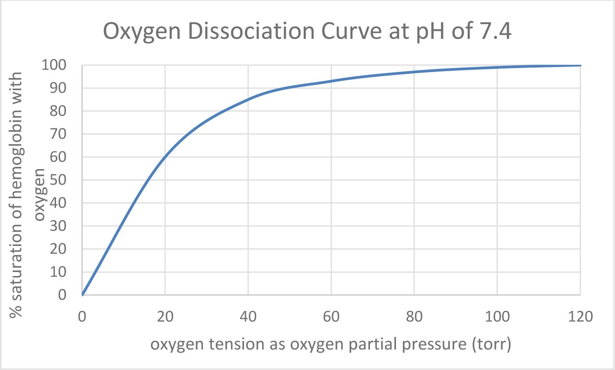
Questions
Draw your prediction for what will happen to the binding affinity of hemoglobin for oxygen if you increased the pH or created a more alkaline situation. (Hint: you need two lines on the graph to show “normal” and an increase in pH.)

Slide 28
How does pH influence oxygen saturation of hemoglobin at the same partial pressure?
How does pH affect hemoglobin affinity for oxygen in the body tissue that is metabolically active? What is the significance of this hemoglobin affinity difference?
How would the respiration rate impact this curve given the changes in blood pH?

Slide 29
Part III – Mixing Alcohol with Energy Drinks
NATIONAL CENTER FOR CASE STUDY TEACHING IN SCIENCE
Susan told both Sam and Ashton that Blake was fortunate to be stable and not in worse shape. She showed Sam and Ashton the following abstract from one of her research papers that she was using for an assignment she was working on for her degree. Despite the fact that it was published before they were born, the take-home message did sink in. ftere were a lot of big words in the abstract, but they knew what a coma was and perhaps Blake had been lucky tonight.

Slide 30
Abstract
Over 10% of emergency room patients are diagnosed as having alcohol (6.0%) or drug intoxication. In the present study 196 alcohol intoxications treated in a hospital were studied retrospectively; 49.2% of the patients had abnormal acid-base values, alcoholics more often than non-alcoholics (p = 0.04). Mean blood ethanol concentration (BAC) was 310 mg/dl (SD 120); alcoholics had higher concentrations of alcohol. BAC was the higher the lower the serum pH was (p less than 0.002, r = -0.45). The deeper the coma the lower the serum pH (p less than 0.05) and the higher the BAC (p less than 0.0001). Respiratory acidosis (31.7%) was an important finding in those intoxicated. Metabolic acidosis (7.9%) could be explained by the presence metabolites of ethanol in the serum and by decreased extra-cellular fluid volume. Metabolic alkalosis related to vomiting and an extra-cellular fluid volume decrease was found in 7.9% of the patients. Respiratory alkalosis was a rare finding (1.6%). Hypokalemia (22.5%) and hypernatremia (15.3%) were the most important electrolyte changes. Chronic alcoholics had lower serum potassium than had non- alcoholics; 3.6% (n = 7) of the patients had to be intubated. Acid-base disturbances were frequent in adults with alcohol intoxication. Serum pH correlated well with the state of consciousness and the BAC.

Slide 31
Questions
Define the following terms:
respiratory acidosis
metabolic acidosis
coma
Compare/contrast respiratory acidosis to the case study scenario.
Suppose you were to drink an energy drink (with caffeine or another stimulant like guarana or gensing) while consuming alcohol. Would there be an impact on the amount of alcohol consumed? Please explain in terms of the acid-base balance in your body.

